Slide 1
Web Introduction

Slide 2
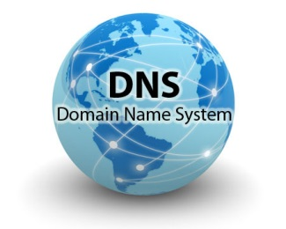
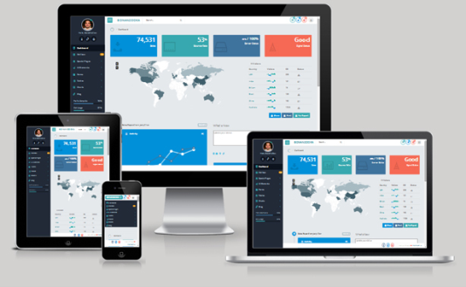

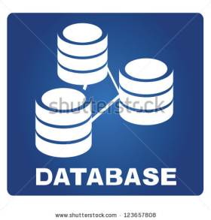
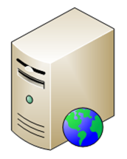
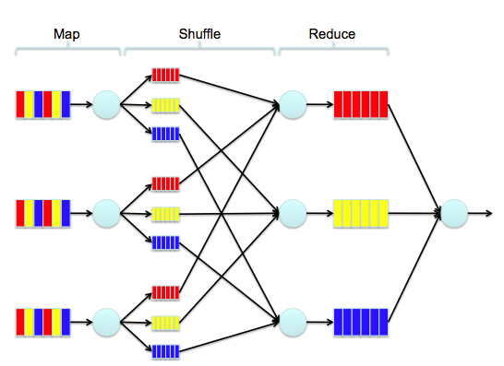
Web Overview
www.google.com
Frontend
Browser
IP XXX.XXX.XXX.XXX
Backend
Proxy server
HTTP server

Slide 3
Topics
Frontend
Backend
Big-Data

Slide 4
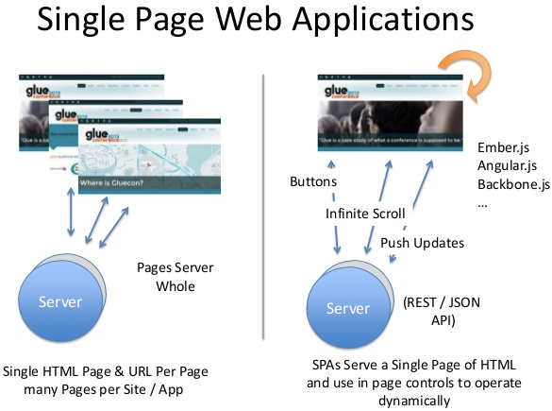
Frontend Web Framework

Slide 5
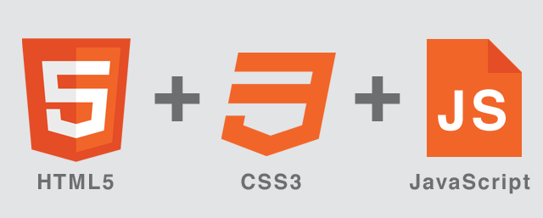





Frontend Web Framework

Slide 6

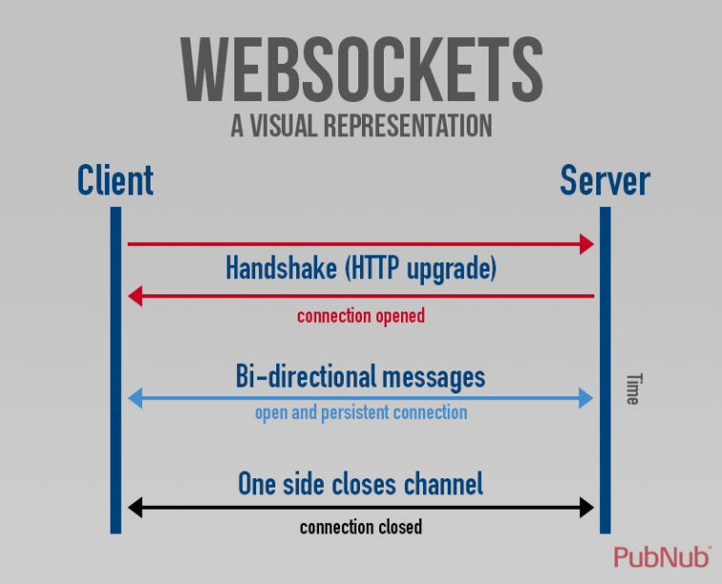

Event Driven Web Application
Different traditional request/response connection
Scenario
Server want to active to send event to client
Notification

Slide 7
Topics
Frontend
Backend
Big-Data

Slide 8
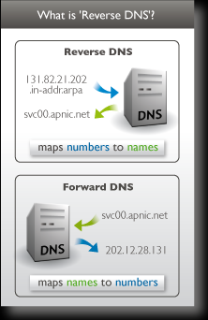
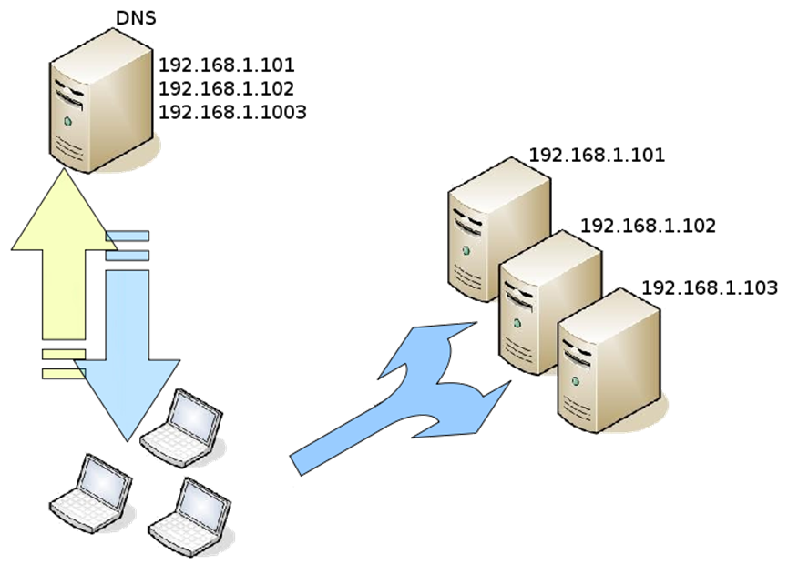
DNS
DNS Round-Robin

Slide 9




HTTP Server
Different Polling
Nginx use epoll polling
Apache use select polling, although 2.4 has epoll
JVM HTTP server
Why Google choose Jetty?
http://www.infoq.com/news/2009/08/google-chose-jetty

Slide 10






Which Linux OS is almost as web server?

Slide 11
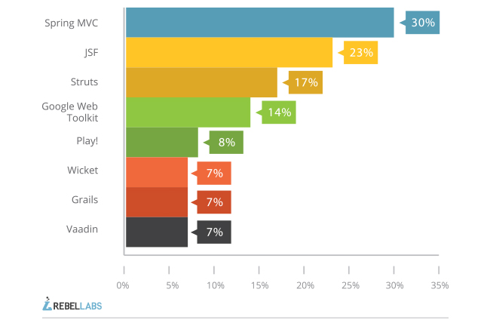
Backend Web Framework
Java Web Framework

Slide 12
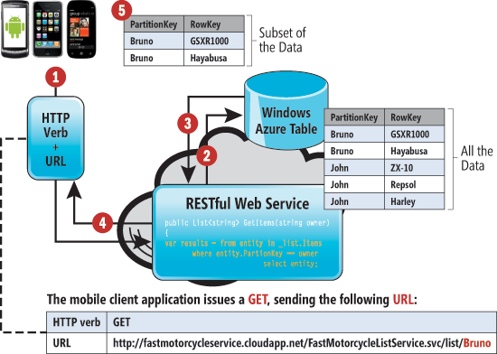
Backend Web Framework
RESTful for Web API

Slide 13
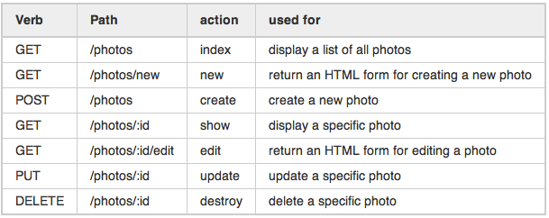
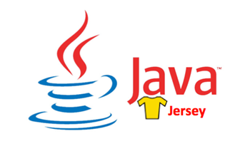
Backend Web Framework
RESTful

Slide 14
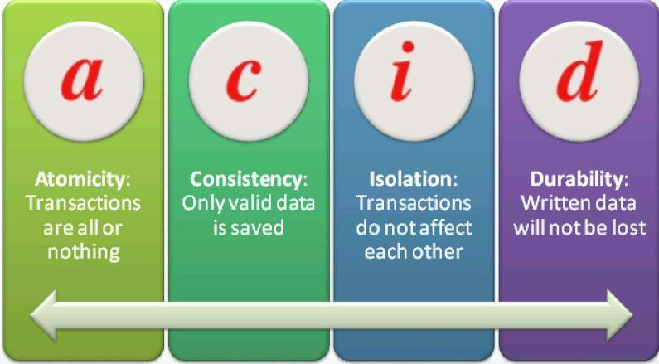
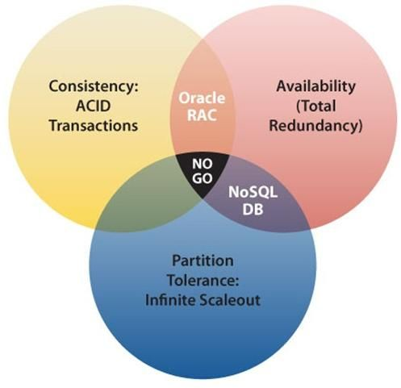

Database Concept

Slide 15



RDBMS
Review
SQL language:
JOIN (inner join, outer join, left join , right join)
GROUP BY

Slide 16
Topics
Frontend
Backend
Big-Data

Slide 17
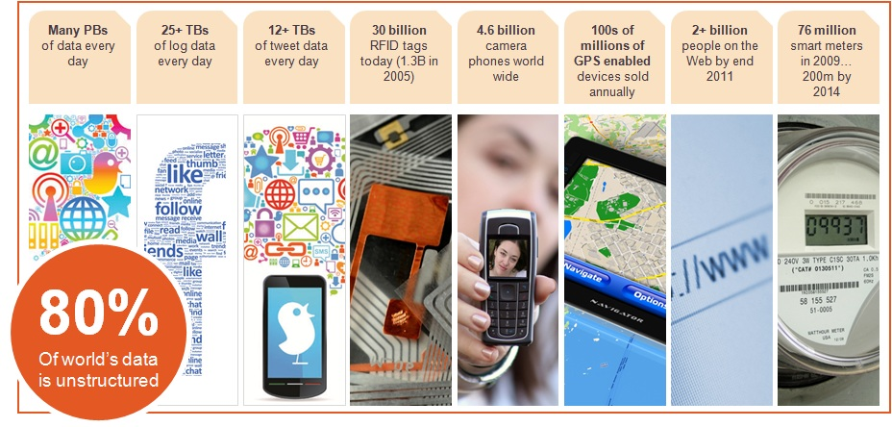
What is Big Data ?

Slide 18
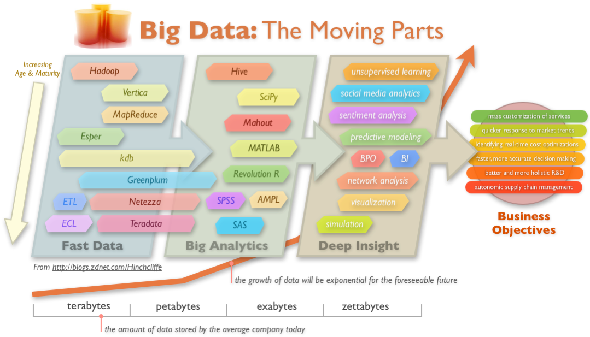
What is Big Data ?

Slide 19
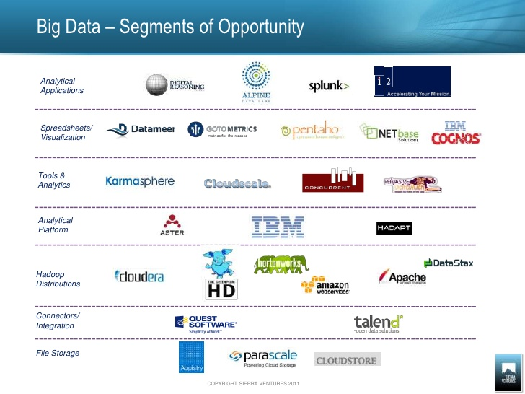
Big Data Ecosystem

Slide 20
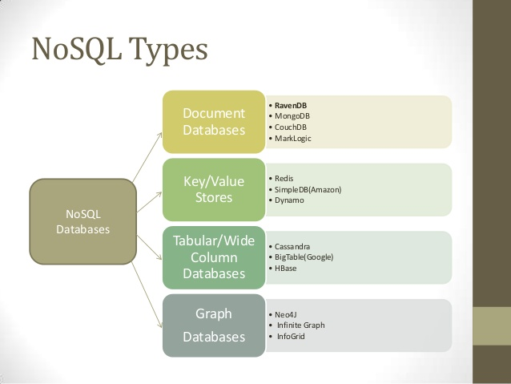
NOSQL
http://www.slideshare.net/VenkatSomula/nosql-ravendb

Slide 21





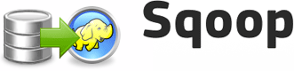

NOSQL

Slide 22
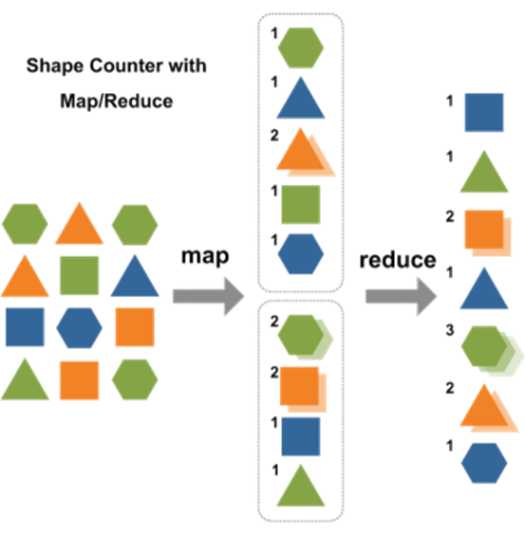
Map-Reduce Design Pattern
http://buzzorange.com/techorange/2013/05/14/big-data-beyond-mapreduce/

Slide 23


Map-Reduce Design Pattern

Slide 24
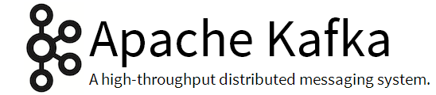
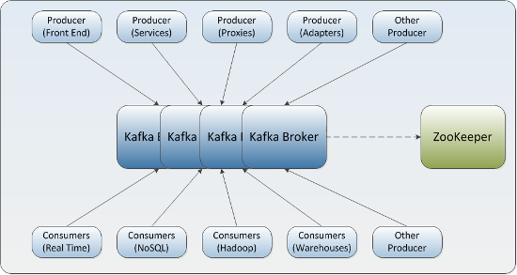
Message Queue

Slide 25

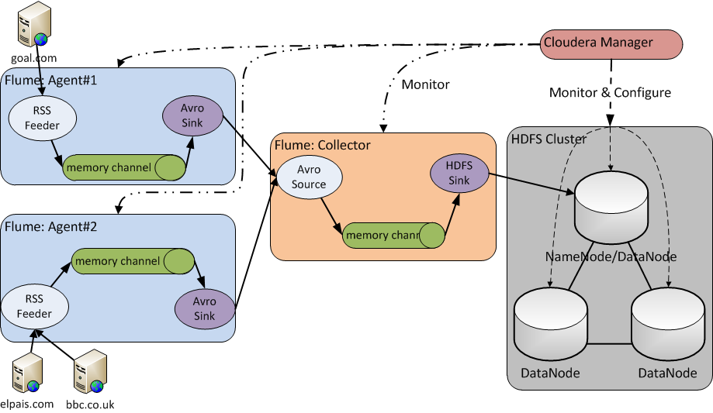
Distributed Service

Slide 26

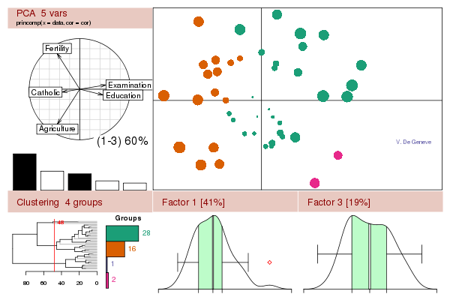
Visualization

Slide 27
Java Project Build Tool
Maven
Gradle

Slide 28
Thanks for your attention

